Slide 1

Manchester Triage System Telephone Triage and Advice
Post Publication Updates

Slide 2
Post Publication Updates
This slide set contains all post publication updates for MTS Telephone Triage and Advice
The Manchester Triage Group review all charts and discriminators yearly at the annual conference, whereby each country that uses MTS sends 3 representatives and any recommendations for changes are discussed with the group. Many of these changes are minor changes or additions to charts/discriminators and these will be released annually following the conference, however if there are any critical safety updates, you will be informed of these straight away so you can update your system.

Slide 3
Post Publication Updates
It is the responsibility of the instructors to ensure that once you have been informed of any changes, that these are made to the systems you are using.

Slide 4
Manchester Triage System Telephone Triage and Advice
Post Publication Updates
October 2017

Slide 5

Patient Safety Updates: Addition of new discriminator ‘Possible Sepsis’ to relevant charts
Definition: Suspected sepsis in patients who present with altered mental state, low blood pressure (systolic less than 100) or raised respiratory rate (more than 22). In children, age specific physiological values should be used to determine if possibly septic.

Slide 6

QSOFA

Slide 7
Patient Safety Update: ‘Ingestion of a dangerous object’
New discriminator ‘Ingestion of a dangerous object’ added to Foreign body and Worried parent charts
Definition: Ingestion of a dangerous foreign object e.g. button battery, magnets or razor blades which may be a potential threat to life
These are just some examples, not an exhaustive list.

Slide 8
General Updates: ‘Abdominal pain in children’
Discriminators added to Abdominal pain in children chart:
‘PV Blood loss and 20 weeks pregnant or more’ in Red
‘Possibly pregnant’ in Yellow

Slide 9
General Updates: ‘Reduced foetal movements’
New discriminator ‘Reduced foetal movements’ added to Pregnancy chart
Definition: Absent or reduced foetal movements during the previous 12 hours in a woman known to be beyond the 20th week of pregnancy.

Slide 10
General Updates: ‘Cold’
‘Cold’ discriminator removed from all TTA charts as this was always meant to capture patients exposed to the elements not as a marker of sepsis. Due to the difficulties in assessing this discriminator remotely, this has now been removed.

Slide 11
General Updates: ‘Inappropriate history’
‘Inappropriate history’ added to all relevant TTA charts
Inappropriate history has always been a face to face discriminator, however it was added to TTA, not as a question to be asked, but as a prompt to remind the clinician to be mindful of any red flags that may be present during the assessment that may suggest there is a safeguarding concern.

Slide 12
General Updates: ‘Collapsed adult’
Name of chart changed from ‘Collapsed adult’ to ‘Collapse’ to enable this chart to be used for a patient of any age.

Slide 13
General Updates: ‘Drooling’
‘Drooling’ added to Allergy in FTF now to ensure consistency with other charts.

Slide 14
General Updates: ‘Inhalation injury’ and ‘Smoke exposure’
‘Inhalation injury’ and ‘Smoke exposure’ added to Chemical exposure and Shortness of breath charts (Adult and children)
This is to ensure that if a patient is not presenting with burns or scalds, then inhalation injury and smoke exposure are still considered.

Slide 15
General Updates: ‘Significant haematological history’
‘Significant haematological history’ changed to ‘ Significant haematological or metabolic history’
Notes:
Probably more used in paediatrics but could be seen in adults as well.
Common blood disorders include anemia, bleeding disorders such as hemophilia, blood clots, and blood cancers such as leukemia, lymphoma, and myeloma.
Hurler syndrome (abnormal bone structure and developmental delay)
Niemann-Pick disease (babies develop liver enlargement, difficulty feeding, and nerve damage)
Tay-Sachs disease (progressive weakness in a months-old child, progressing to severe nerve damage; the child usually lives only until age 4 or 5)
Gaucher disease (bone pain, enlarged liver, and low platelet counts, often mild, in children or adults)
Fabry disease (pain in the extremities in childhood, with kidney and heart disease and strokes in adulthood; only males are affected)
Krabbe disease (progressive nerve damage, developmental delay in young children; occasionally adults are affected)
Galactosemia: Impaired breakdown of the sugar galactose leads to jaundice, vomiting, and liver enlargement after breast or formula feeding by a newborn.
Maple syrup urine disease: Deficiency of an enzyme called BCKD causes buildup of amino acids in the body. Nerve damage results, and the urine smells like syrup.
Phenylketonuria (PKU): Deficiency of the enzyme PAH results in high levels of phenylalanine in the blood. Intellectual disability results if the condition is not recognized.
Glycogen storage diseases: Problems with sugar storage lead to low blood sugar levels, muscle pain, and weakness.

Slide 16
General Updates: Recent problem
‘Recent problem’ added to Pregnancy chart to maintain consistency.
Notes:
Continuity with other charts

Slide 17
General Updates: ‘New confusion’
New discriminator ‘New confusion’ added to Unwell adult chart
Definition: Patients with onset of new confusion
Patients with new onset confusion may not necessarily trigger a high clinical priority therefore ‘New confusion’ has been added to make sure these patients don’t slip through the net.

Slide 18
Manchester Triage System Telephone Triage and Advice
Post Publication Updates
2018/2019

Slide 19
Patient safety update: ‘Signs of shock’
‘Signs of shock’ added to all relevant discriminators
Definition: ‘Shock is inadequate delivery of oxygen to the tissues. The classic signs include sweating, pallor, tachycardia, hypotension and reduced conscious level’

Slide 20
General update: ‘Massive Haemoptysis’
New discriminator ‘Massive Haemoptysis’ added to the following charts;
Torso injury
Chest pain
Shortness of breath in adults/children
Definition: ‘Coughing up large amounts of fresh or clotted blood. Not to be confused with streaks of blood in saliva’

Slide 21
General update: Testicular pain
‘Age 25 years or less’ priority increased to Red To ensure consistent priority with Emergency Triage
‘Testicular pain’ added to Abdominal pain in children chart in Red to ensure testicular pain is questioned with a child presenting with abdominal pain, as children may not be able to articulate this accurately.

Slide 22
General update: ‘Aortic pain’
Discriminator ‘Aortic pain’ added to the following charts:
Back pain
Chest pain
Collapse
Discriminator ‘Aortic pain’ replaced ‘Pain radiating into back’ in the Abdominal pain chart.

Slide 23
‘Aortic pain’ definition:
The onset of symptoms is sudden and the leading symptom is severe abdominal or chest pain. The pain may be described as sharp, stabbing or ripping in character. Classically aortic chest pain is felt around the sternum and then radiates to the shoulder blades, aortic abdominal pain is felt in the centre of the abdomen and radiates to the back. The pain may get better or even vanish and then recur elsewhere. Over time, pain may also be felt in the arms, neck, lower jaw, stomach or hips.

Slide 24
General update: 'Responds to pain'
Definition of 'Responds to pain' amended to;
‘Response to a painful stimulus. Standard peripheral stimuli should be used - a pencil or pen is used to apply pressure to the finger nail bed. This stimulus should not be applied to the toes since a spinal reflex may cause flexion even in brain death.’
The wording 'Supraorbital ridge pressure should not be used since reflex grimacing may occur‘ has been removed.

Slide 25
General update
‘Special risk of infection’ and ‘History of foreign travel’ added to the following charts:
Unwell newborn
Unwell baby
Unwell child

Slide 26
Manchester Triage System Telephone Triage and Advice
Post Publication Updates
2020

Slide 27
General update: ‘Possible sepsis’ definition amended
Definition: Suspected sepsis in patients who present with altered mental state, low blood pressure (systolic less than 100) or raised respiratory rate (more than 22). In children, age specific physiological tools should be used to determine if possibly septic.
Changed from age specific ‘values’ to age specific ‘tools’ due to translation issues.

Slide 28
Manchester Triage System Telephone Triage and Advice
Post Publication Updates
December 2022 – Patient Safety Update: Mental Health

Slide 29
Updates to Mental Health Charts
The Manchester Triage Group updated all of the mental health related charts following a pilot evaluation and a Delphi study.
The initial changes were made to Emergency Triage, and many of these discriminators have now been carried across to telephone triage following reviews and discussions with the telephone triage advisory and international groups.

Slide 30
Updates to Mental Health Charts
This has been the biggest change to the MTS since it began in order to ensure mental health is given the same importance as physical health.

Slide 31
Mental Health Chart Update
There have been a number of updates to the following charts, with the addition of a number of new mental health discriminators;
Apparently drunk
Behaving strangely
Mental illness
Overdose and poisoning
Self harm

Slide 32
Mental Health - New Red Discriminators
High risk of self harm / further self harm
High risk to others
Severe aggression or agitation that may require restraint
High risk of leaving before assessment
Apparently hallucinating
New symptoms of psychosis

Slide 33
Mental Health - New Yellow Discriminators
Moderate aggression or agitation
Moderate risk of leaving before assessment
Moderate risk of self harm / further self harm
Moderate risk of harm to others
Recently given birth

Slide 34
Mental Health - New Green Discriminators
New onset of significant mental health symptoms
Self harmed without other psychiatric disease
Discharged from mental health services within the last 15 days
Safeguarding concerns

Slide 35
Mental Health Chart Updates
In addition to the new discriminators, the Mental illness chart also has new Green and Blue priorities.

Slide 36
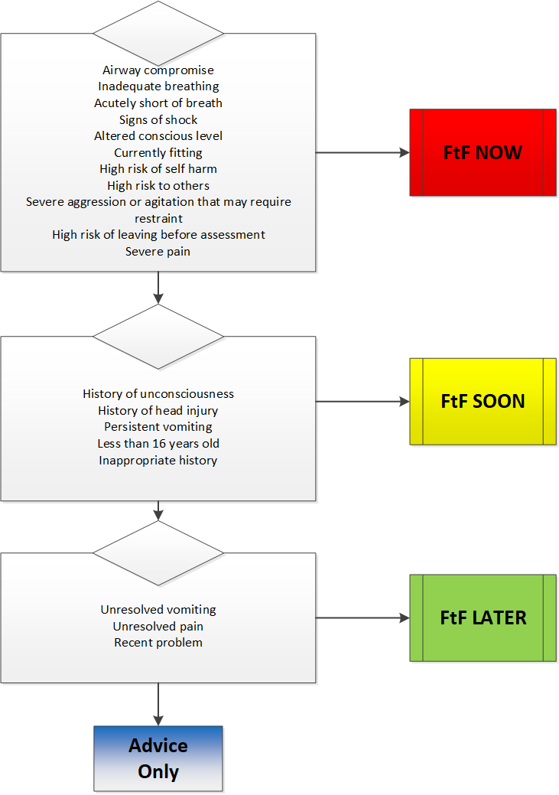
Apparently drunk

Slide 37
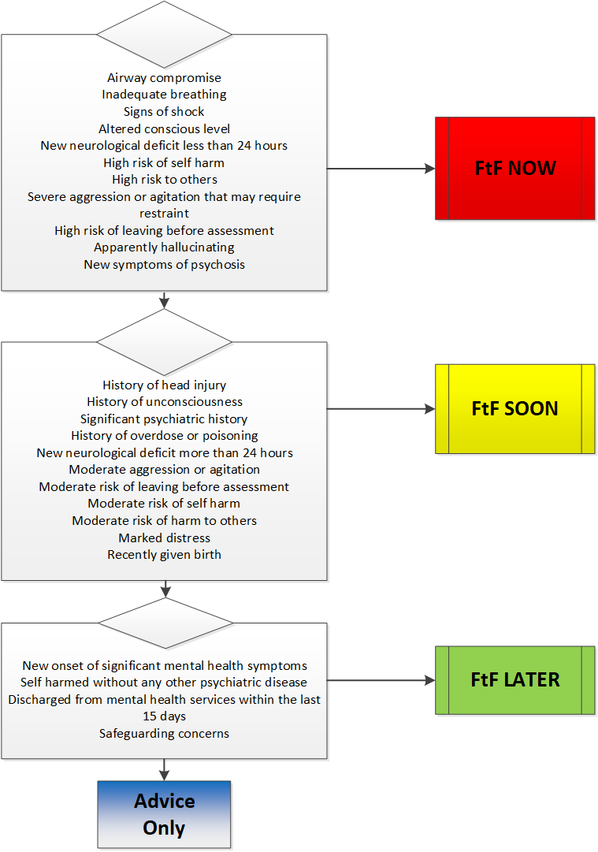
Behaving strangely

Slide 38
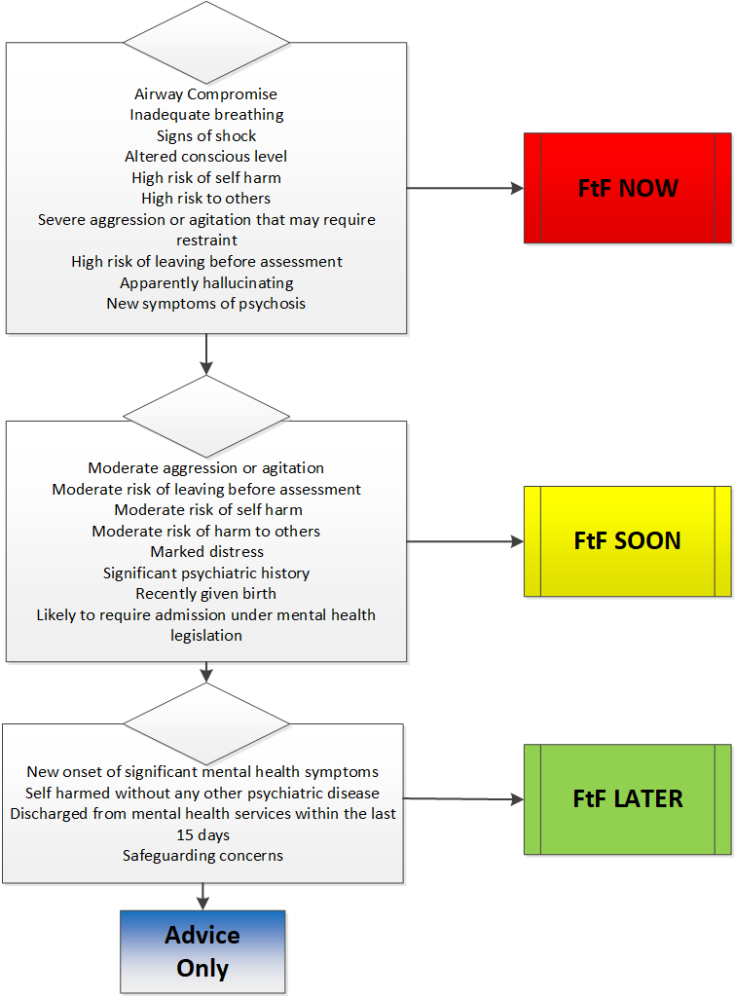
Mental illness

Slide 39
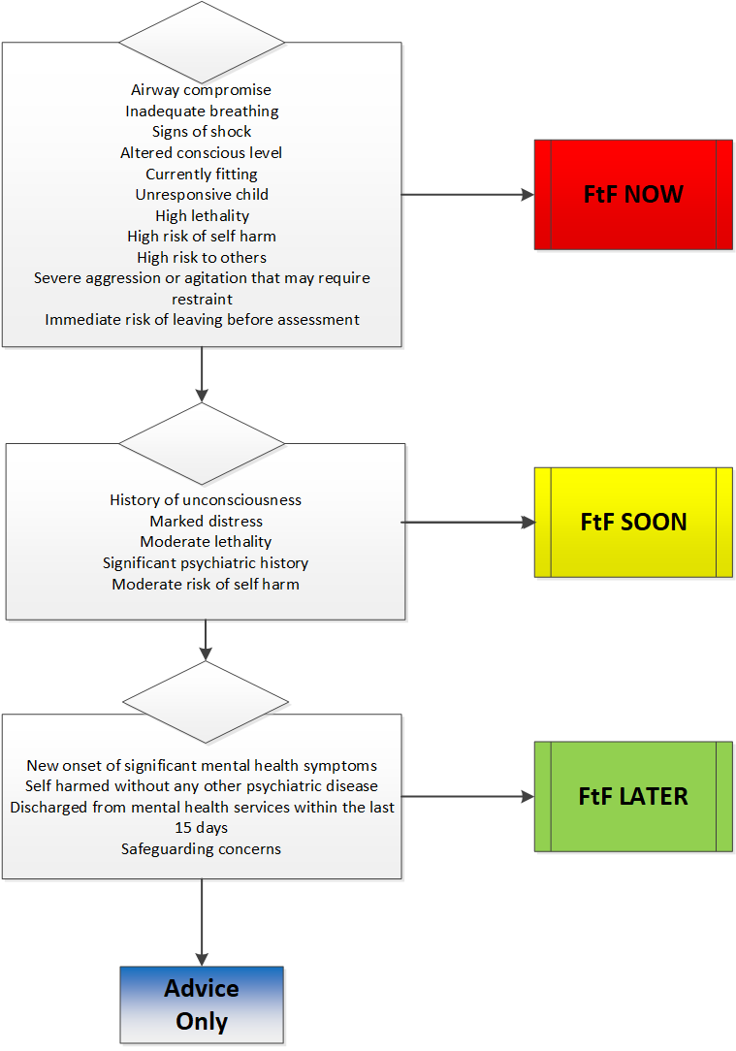
Overdose and poisoning

Slide 40
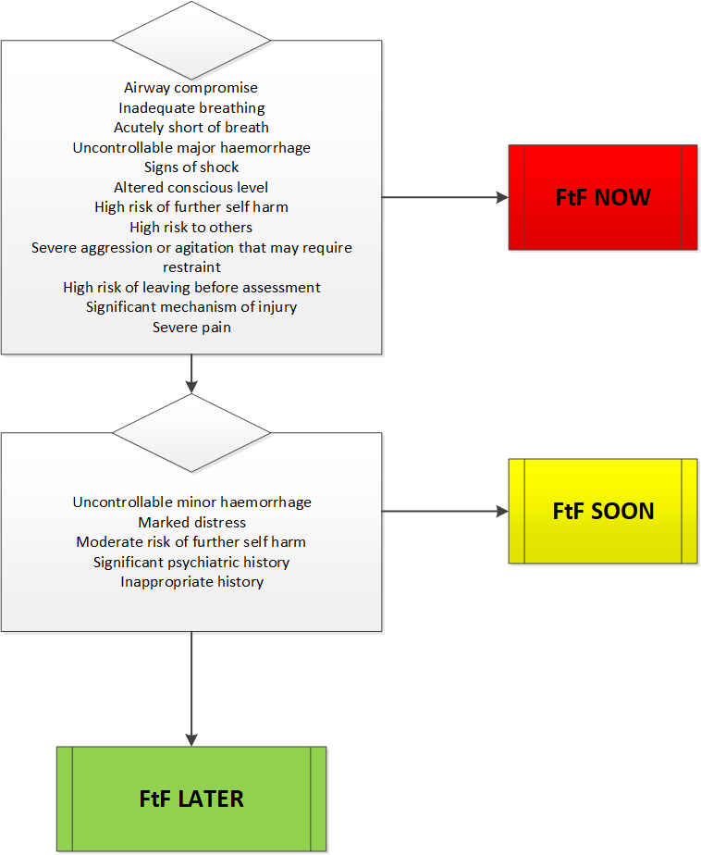
Self harm

Slide 41
Discriminators, definitions and question bank
Apparently hallucinating | Have you been hearing or seeing things that no one else has seen or heard? Is this the first time you have heard voices? What have the voices been telling you to do? | Patients who are apparently hallucinating may appear distracted and may appear to react to stimuli (primarily visual and auditory) that are not apparent to anyone else

Slide 42
Discriminators, definitions and question bank
Discharged from mental health services within the past 15 days | Have you been recently discharged from any mental health services in the past 15 days? | Any patient who has been discharged from an active period of care under mental health services (in hospital or in the community) within the past 15 days
Increased risk immediately following psychiatric discharge

Slide 43
Discriminators, definitions and question bank
High risk of further self-harm | Are you actively harming yourself at the moment or planning to harm yourself in any way? Can I ask what you have used/are planning on using? Do you have access to that at the moment? | An initial view of the risk of harm to self can be formed by considering the patient's behaviour. Patients who are threatening to harm themselves and who are actively seeking the means to do so are at high risk

Slide 44
Discriminators, definitions and question bank
High risk of leaving before assessment | Are you able to wait for someone to arrive so they can assess you? | Active, credible threats to leave prior to assessment pose a high risk
High risk of self-harm | Are you actively harming yourself at the moment or planning to harm yourself in any way? Can I ask what you have used/are planning on using? Do you have access to that at the moment? | An initial view of the risk of harm to self can be formed by considering the patient's behaviour. Patients who are threatening to harm themselves and who are actively seeking the means to do so are at high risk

Slide 45
Discriminators, definitions and question bank
High risk to others | Speech patterns would be determined by talking to the patient however in order to assess behaviour and posture it may be necessary to ask questions to someone who is with the patient if possible. Have you been physically harmed? Do you feel the patient is a risk to you? | An initial view of the risk of harm to others can be judged by assessing posture (tense, clenched), speech (loud, using threatening words) loud background noise can be an indicator and motor behaviour (restless, pacing, lunging at others). High risk should be assumed if weapons and potential victims are available and no controls are already in place

Slide 46
Discriminators, definitions and question bank
Likely to require admission under mental health legislation | This will be subjective based on responses to the questions you have already asked | Patients with significant psychiatric symptoms who are likely to require admission under mental health legislation
Moderate aggression or agitation | This will be subjective based on the patients responses to other questions. If the caller has witnessed this in the patient before have they been able to verbally de-escalate Are you managing to de-escalate the situation/keep the patient calm? | Agitation or aggression that can usually be managed by verbal de-escalation without physical restraint

Slide 47
Discriminators, definitions and question bank
Moderate risk of further self harm | Are you actively harming yourself at the moment or planning to harm yourself in any way? Can I ask what you have used/are planning on using? Do you have access to that at the moment? | An initial view of the risk of harm to self can be formed by considering the patient's behaviour. Patients without a significant history of self harm, who are not actively trying to harm themselves, but who profess the desire to harm themselves are at moderate risk

Slide 48
Discriminators, definitions and question bank
Moderate risk of harm to others | Speech patterns would be determined by talking to the patient however in order to assess behaviour and posture it may be necessary to ask questions to someone who is with the patient if possible. | An initial view of the risk of harm to others can be judged by assessing posture (tense, clenched), speech (loud, using threatening words) using threatening words) loud background noise can be an indicator and motor behaviour (restless, pacing, lunging at others). Moderate risk should be assumed if there is any indication of potential harm to others

Slide 49
Discriminators, definitions and question bank
Moderate risk of leaving before assessment | Are you able to wait for someone to arrive so they can assess you? | Threats to leave without any attempts to do so pose a moderate risk
Moderate risk of self harm | Are you actively harming yourself at the moment or planning to harm yourself in any way? Can I ask what you have used/are planning on using? Do you have access to that at the moment? | An initial view of the risk of harm to self can be formed by considering the patient's behaviour. Patients without a significant history of self harm, who are not actively trying to harm themselves, but who profess the desire to harm themselves are at moderate risk

Slide 50
Discriminators, definitions and question bank
New onset of significant mental health symptoms | These symptoms you are experiencing today, are these completely new for you? Have you experienced them before? | Any new mental health symptoms not already taken into account

Slide 51
Discriminators, definitions and question bank
New symptoms of psychosis | Do you feel that people are out to get you or do you feel that you are going to be harmed Who do you think is going to harm you, is it a person or is it a thing Have you experienced these feelings before | Active new symptoms of psychosis with no insight such as hallucinations, delusions and/or paranoia

Slide 52
Discriminators, definitions and question bank
Recently given birth | Have you given birth within the last three months? | A woman who has given birth within the past 3 months
Around 1 in 500 women develop post partum psychosis)

Slide 53
Discriminators, definitions and question bank
Safeguarding concerns | This will be subjective based on responses to the questions you have already asked | Any concerns for the welfare of the patient that arise from their vulnerability
This is different to ‘Inappropriate history’ which is an immediate marker of safeguarding.
‘Safeguarding concerns’ would be used if you are concerned for the patient due to their vulnerability.

Slide 54
Discriminators, definitions and question bank
Self-harmed without other psychiatric disease | This will be subjective based on responses to the questions you have already asked | Patients who have harmed themselves (for the first or subsequent time) who do not have a mental health diagnosis
Severe aggression or agitation that may require restraint | Have you been physically harmed? Do you feel the patient is a risk to you? How will the patient react to the ambulance arriving? If you feel at risk remove yourself and others from the patient | Aggression and agitation of such a degree that restraint may be required at short notice to manage the risk of harm to self or others

Slide 55
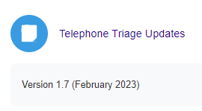
Updates Log
A complete list of all updates and amendments can be found on the MTS website in your Telephone Triage Hub
The are displayed on an excel mapping document which can be easily filtered to find the information relating to specific versions, charts or discriminators.

Slide 56
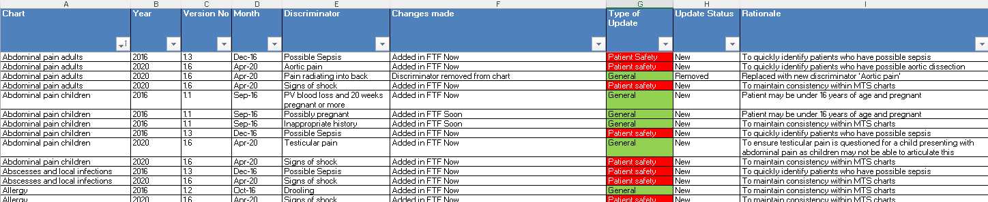
Updates www.triagenet.net

Slide 57

If you have any questions, please contact manchestertriage@alsg.org

